Slide 1
Real-Time Facial Emotion Detection Desktop Application

Slide 2
Introduction & Motivation
Humans naturally interpret emotions, but computers struggle with real-time understanding.
Existing systems:
  Require high computational power (GPU)
  Depend on internet/cloud processing
  Not optimized for low-resource environments
Motivation
Build a real-time, offline, CPU-efficient system capable of detecting emotions from facial expressions.

Slide 3
Dataset
It is a combination of standard datasets
    FER2013 ------large but noisy,
    CK+ -----------clean but small,
    AffectNet ---- diverse, and
    KDEF ---------well-posed.
Why did we combine multiple datasets?
What technique did we use to combine?
Why did we balance the dataset?
How does dataset size affect performance?

Slide 4
Dataset Characteristics
Dataset Size
Balanced (equal samples per each class)
7 emotion classes:
  Angry,
  Disgust,
  Fear,
  Happy,
  Sad,
  Surprise,
  Neutral
Training set:
  6,400 images × 7 emotions = 44,800 images
Testing set:
  1,600 images × 7 emotions = 11,200 images
Total size:
  56,000 images

Slide 5
Model Training
Deep layers
Conv2D(32, (3,3), padding='same')(inputs)
Conv2D(64, (3,3), padding='same')(x)
Conv2D(128, (3,3), padding='same')(x)
Conv2D(256, (3,3), padding='same')(x)

Slide 6
First trial
Parameters
  IMAGE_SIZE = (48, 48) - reduce computational load
  BATCH_SIZE = 32
    Too small batch: Model may underfit (noisy updates, slow convergence).
    Too large batch: Model may overfit (memorizes patterns, less generalization).
  EPOCHS = 25
  NUM_CLASSES = 7
  COLOR_MODE = "grayscale“
Test Accuracy: 61.04%

Slide 7
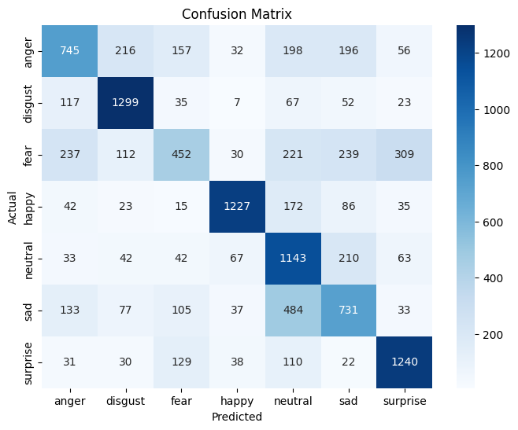
Strong Performance
  Happy (1227),
  Disgust (1299),
  Surprise (1240)
Moderate Performance
  Anger
  Neutral
Weak Performance
  Fear
  Sadness

Slide 8
Current Trial
Parameters
  IMAGE_SIZE = (48, 48) - reduce computational load
    Trade-off: Smaller images may lose fine-grained details, so accuracy can be slightly lower compared to larger inputs.
  BATCH_SIZE = 32
  EPOCHS = 30
  NUM_CLASSES = 7
  COLOR_MODE = "grayscale“
Test Accuracy: 64.10%

Slide 9
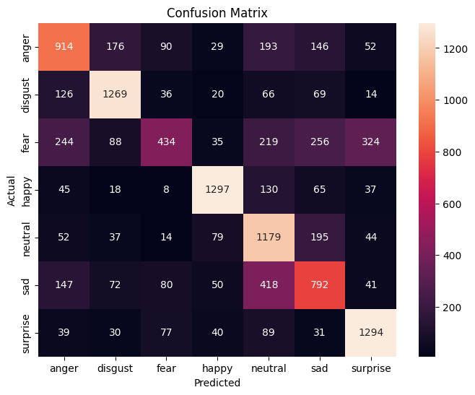
Strong Performance
  Happy (1297 correct),
  Disgust (1269 correct),
  Surprise (1294 correct)
Moderate Performance
  Anger
  Neutral
Weak Performance
  Fear is often mistaken for surprise (wide eyes, open mouth) or sadness.
  Sadness is confused with neutral and anger.

Slide 10
Possible Factors Declining Performance
Feature Overlap Between Emotions
Low Input Resolution (48×48 grayscale)
Training Strategy
Model Architecture Limitations

Slide 11
System Integration (Desktop App)
Framework: PySide6 (Qt for Python)
Layout:
  split into left panel (camera feed) and right panel (controls + results).
  Buttons for Start Camera, Stop Camera, Upload Image, Exit.
  Real-time results displayed:
    Emotion, Confidence, FPS.

